Slide 1
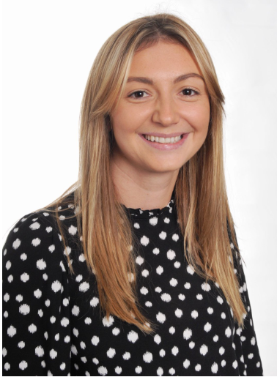
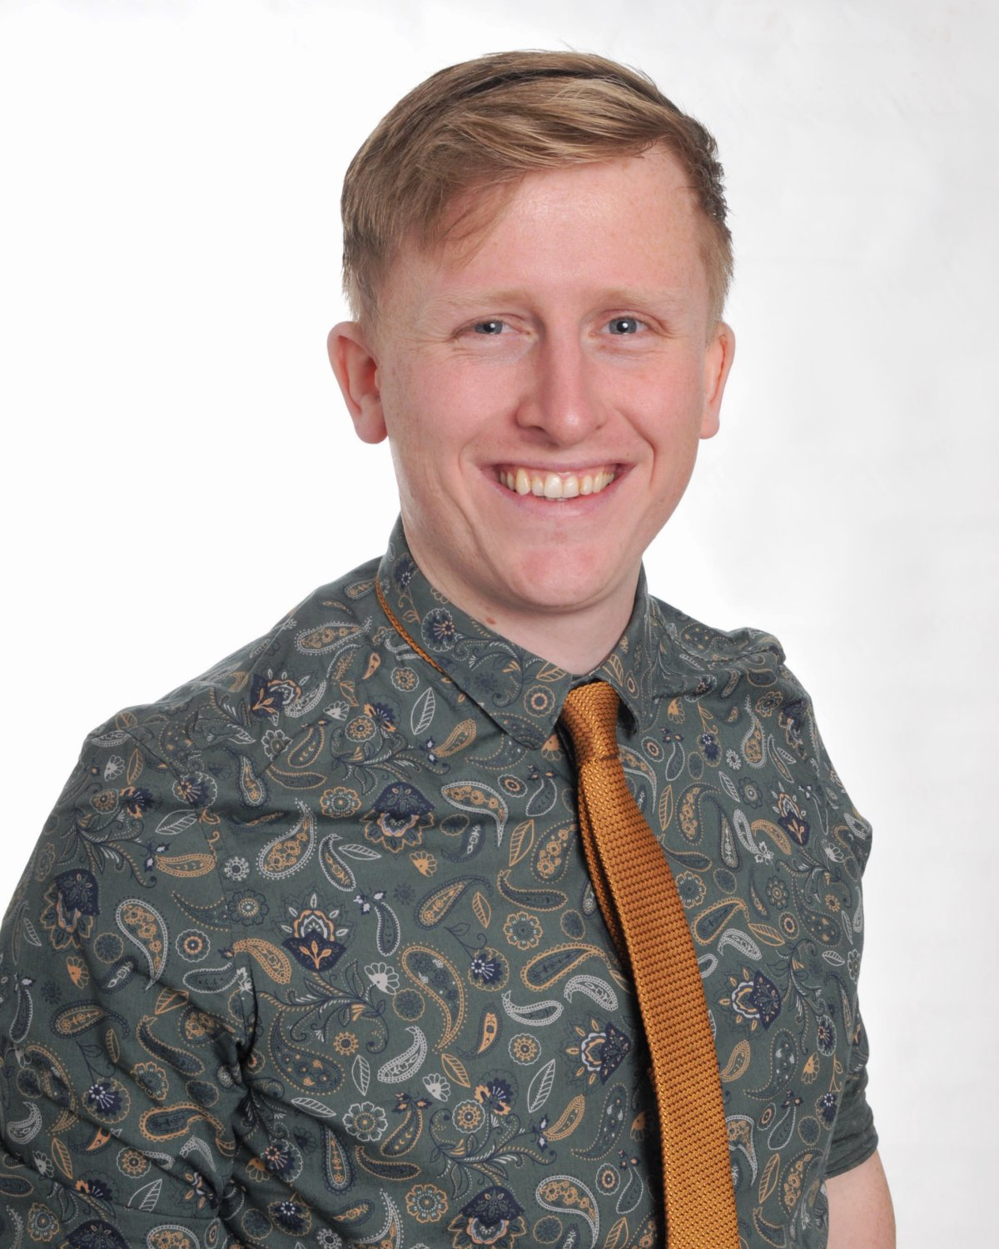
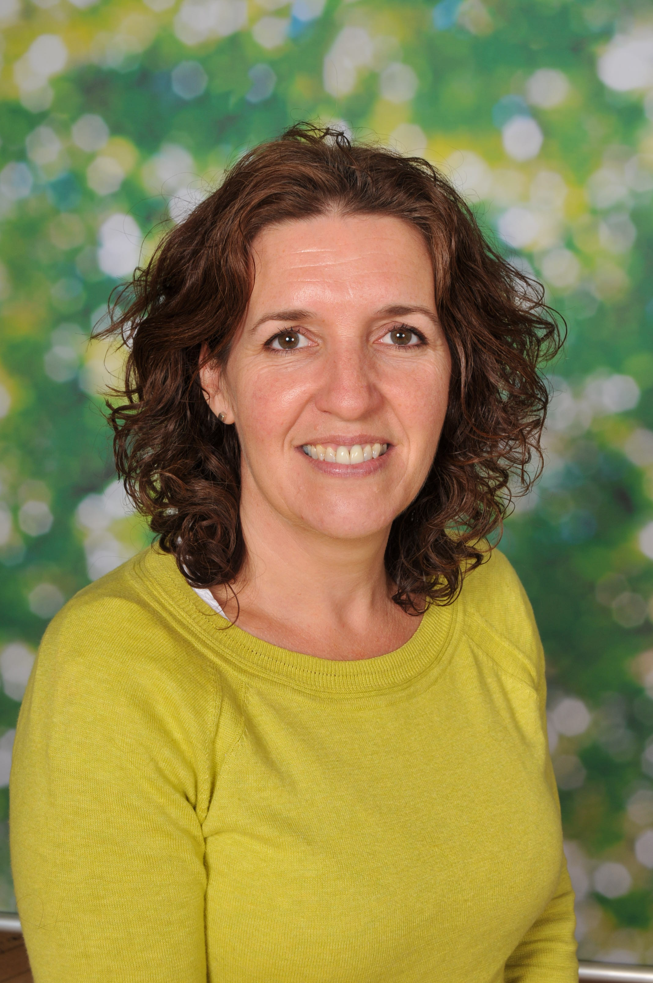
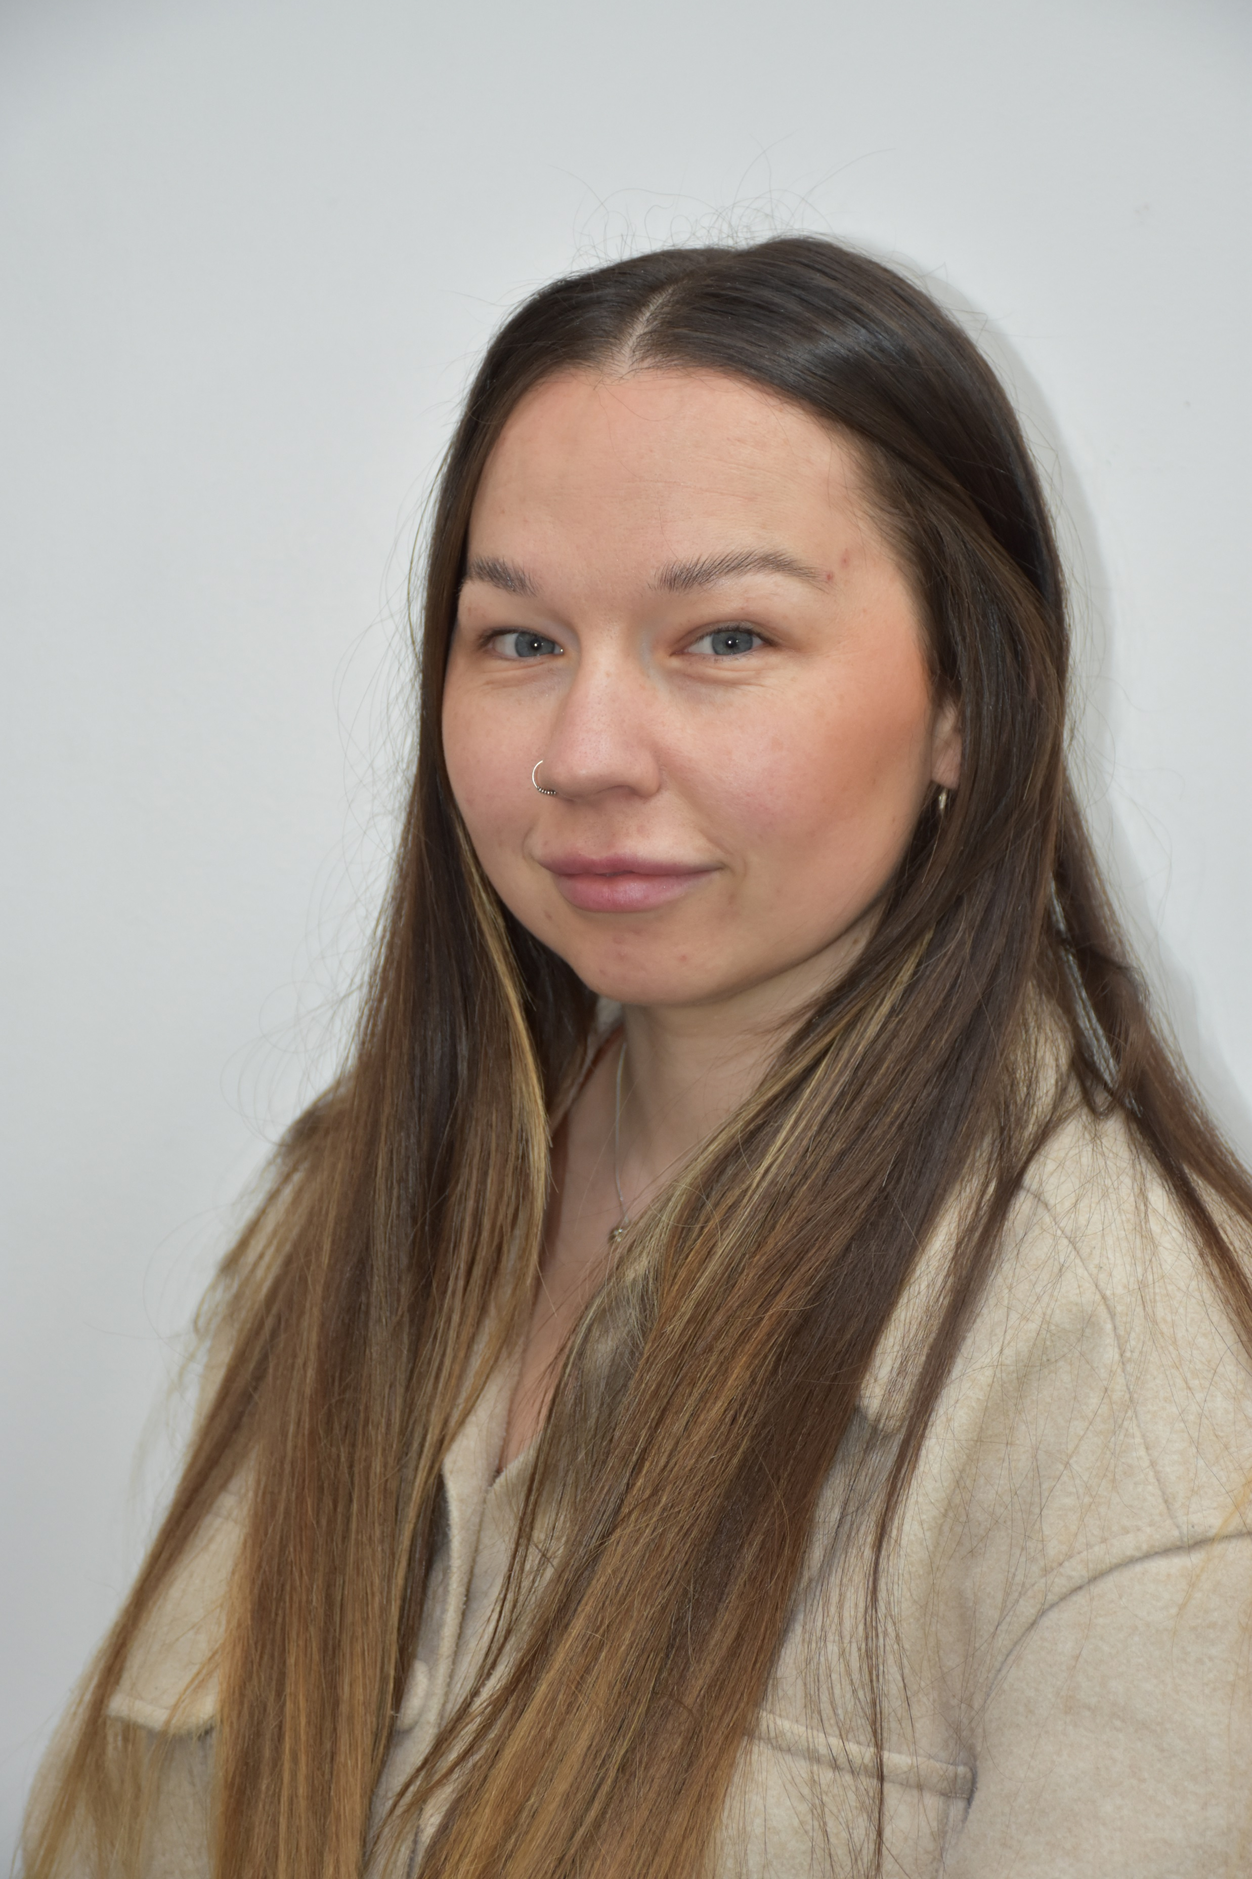
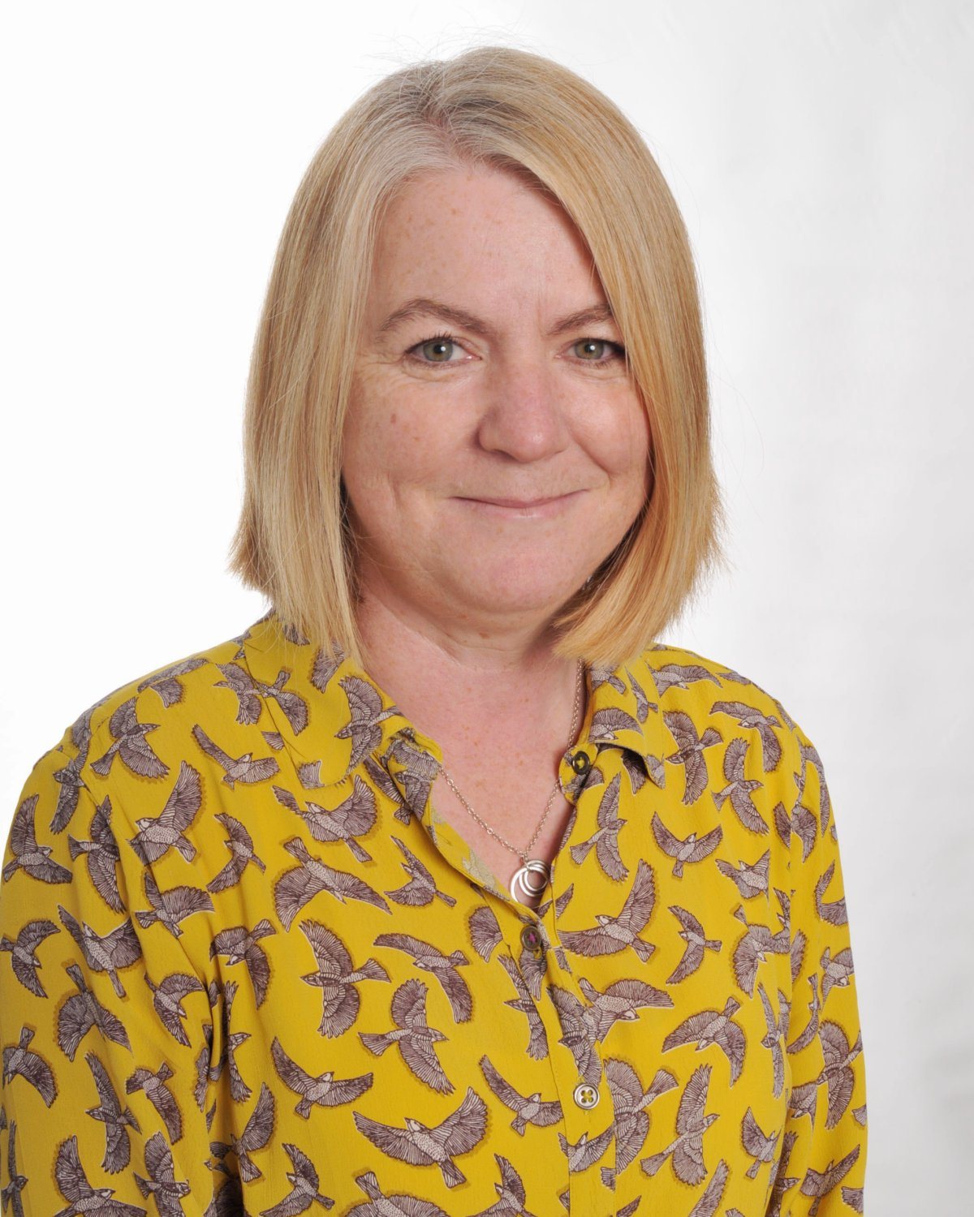
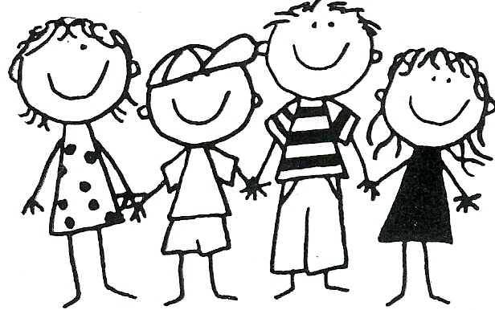
Curious, Creative, Confident Foundation
PE Day
Tuesday’s and Thursday’s
Children do not need to wear P.E kit during Autumn Term 1 and you will be given more details about this nearer the time.
The School Day
08:40 Arrive at School
(gates close at 08:50)
11:50 – 12:50 Lunch Time
15:10 End of School Day
Home Learning
Reading: Please read with your child at home. We recommend your child reads for at least 15 minutes x3 a week. This should be a mixture of your child reading to you as well as you reading to them. Please note that reading books will not be sent home until nearer the end of Autumn Term 1. Thank you for your support with this, it makes a huge difference to your child’s learning and progress. ☺
Questions & Queries
If you have any questions or queries, you can speak to a member of the Foundation team, on the door, at the beginning or end of the school day. Alternatively, you can contact your child’s teacher using the class email address. We will get back to you as soon as we can. Thank you!
In regards to attendance, absence, change to end of day pick-ups etc. please contact the school office on 216160 or by email admin@mpsplymouth.net
When it is your child’s birthday, they are allowed to wear mufti clothes into school if they wish. If your child’s birthday falls on a weekend or school holiday, they can wear their mufti clothes on the first day back to school.
Meet the Team
M Mrs Printer classM@mpsplymouth.net
P Mr Abbott classP@mpsplymouth.net
S Mrs Riley and Mrs Atkin classS@mpsplymouth.net
Mrs Faith, Mrs Frost, Mrs Shailer and Mrs Fisher
Learning
‘All About Me’- this is our first topic as most of the first term will be spent getting to know all about your children and settling them into school life. We will spend time looking at school routines, expectations and rules to begin with. Following this, as we draw closer to the end of the first term, we will introduce our new topic ‘Traditional Tales’. Excitingly, to kick start this topic, we have a very special guest appearance organised- Mr Clive Pig. He is a phenomenal story teller and performer and he will help to introduce and immerse our children into many well known traditional tales.
Autumn: All About Me & Traditional Tales

